Slide 1






Slide 2
Content
Software Development Life Cycle
What is Software Testing?
Why we should do Software Testing?
Types of Testing Methodologies
Differences between White Box and Black Testing
Types of Testing
Black Box Testing
Types in Black Box Testing
Testing Life Cycle
Defect Life Cycle
Error, Defect, Bug & Failure

Slide 3
Content
What is Scenario?
Examples for Scenario
Requirement for Registration
Scenarios for Registration Button
Test Case for Registration Button
Differences between Scenario and Test Case
Differences between Priority & Severity

Slide 4
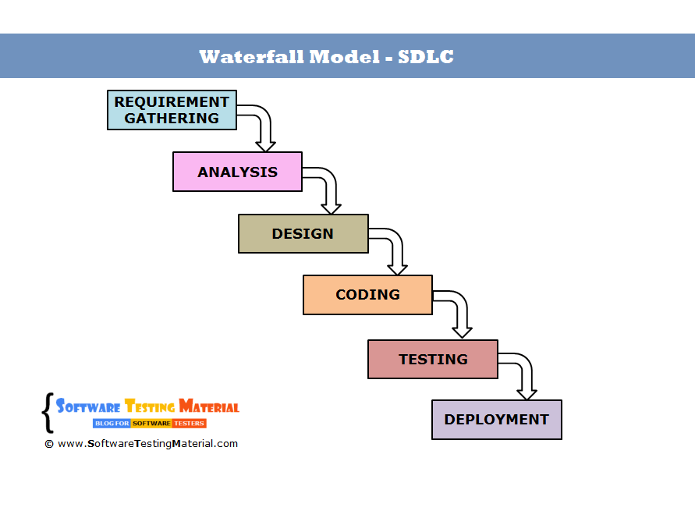
Software Development Life Cycle

Slide 5
What is Software Testing?
Checking the functionality of an application is called software testing.

Slide 6
Why we should do Software Testing?
Every software is developed to support the business.
If there is a defect in the software, it will effect the business and to ensure the quality of software application.
So, before we launch the software to the customer, every defect should be identified and it should be resolved.

Slide 7
Types of Testing Methodologies
White Box Testing
Testing the Source Code of an application.
It is done by developers. Black Box testing
Testing the UI and Functionality of an application.
It is done by Test Engineers. Gray Box Testing
Testing the Source Code and UI and Functionality of an application.
It is done by either Developers or Test Engineers.

Slide 8
Difference Between White Box and Black Box Testing
White Box Testing
Manual Testing:
Write Source Code for an application.
Test each and every LOC(lines of
code) manually.
Automation Testing:
Write Source Code for an application.
Write the program to test the development program using a tool.
For Example: JUNIT Tool - Java,
NUNIT Tool – Dot Net.
Black Box Testing
Manual Testing:
Testing the UI and Functionality of an application manually.
Automation Testing:
Write a program to test the UI and Functionality of an application using tool.
Run the test program in the
tool.(Ex: selenium tool)

Slide 9
Types of Testing
Manual Testing
Checking the functionality of an application is called software testing.
Drawbacks: Manual Regression Testing
Automation Testing
It is the process of testing the application automatically using the automation tool.
Advantages: Saves time and
money.
We can easily do compatibility testing by running the test scripts in multiple platforms simultaneously, this is called parallel execution.
We can generate the reports automatically.

Slide 10
Black Box Testing
Development Environment
Requirement
Testing Environment
Login page: whenever we enter the valid details, navigate to home page.
Login page: we enter the valid details
Software
Compress
Home page
Compile
Source code written by developers

Slide 11
Types in Black Box Testing
Functional Non Functional
Smoke testing
Functional testing
Integration testing
System testing
Retesting
Regression
Exploratory
Acceptance testing
Alpha Beta
Compatibility
Performance
Usability
Adhoc
Accessibility
Globalization
Recovery
Aesthetic
Security

Slide 12
Testing Life Cycle
System study
Write Test Plan
Write Test Cases Prepare RTM
Execute Test Cases Defect Tracking
Test Execution Report Retrospective / Post Mortem Meeting

Slide 13
Defect Life Cycle
New
Deferred Duplicate Can’t fix
Cannot Reproduce Invalid / Rejected
RFE(Request for Enhancement)
Assign
Fixed
Closed
Reopen

Slide 14
Error, Defect, Bug & Failure
“A mistake in coding is called Error, error found by tester is called Defect, defect accepted by development team then it is called Bug, build does not meet the requirements then it Is Failure.”

Slide 15
What is Scenario?
Testing an application in all possible ways.
To find the defects, we have to identify scenarios first. Positive scenarios:
Testing an application with valid inputs. Negative scenarios:
Testing an application with invalid inputs.

Slide 16
Examples for Scenario
Scenarios for Pen:
Positive:
Check if the all parts of the pen is fitting properly and no loose fitting. [Installation Testing]
Check if the pen ball is fitted properly and ball is moving with ease. [Installation Testing]
Check if pen is writing on the page properly. [Functional Testing]
Check if the ink on the paper is belongs with the similar color as what we see in the refill. [Functional Testing]
Check if pressure needs to be applied on the pen to write down on page with least efforts. [Usability Testing]
Size and shape should be confirmable for writing. [UI Testing]
Logo on the pen should be properly printed. [UI Testing] Negative:
Check pen stress testing by dropping pen down from practical height and check if nothing is breaking, no any damage to pen and pen is working without any issues.
Hold the pen upwards direction for some time and try to write on paper.
Keep the pen in water and try to write on paper.
Check how pen is working at different climate environmental conditions like at room temperature, different climate conditions.

Slide 17
Requirement for Registration
User Name: should accept 6 – 32 characters(only alphabets).
Email Id: should accept valid Email Id.
Mobile Number: should accept valid and only 10 digit number.
Password: should accept 5 – 10 characters (any characters).
Registration button: to register the new customer.

Slide 18
Scenarios for Registration Button
Positive:
Enter all the fields with valid data & click on Registration Button.
Enter only mandatory fields & click on Registration Button.
Enter only optional fields & click on Registration Button. Negative:
Enter all the fields with Invalid data & click on
Registration Button.
Leave all the fields & click on Registration Button.

Slide 19
Test Case for Registration Button
Open Browser(chrome, Firefox etc)
Enter website URL
Click on Login/Registration from header
The popup will be displayed
Click on Register from popup
Enter all valid the fields with valid data
Click on registration button
Close the browser

Slide 20
Differences between Scenario and Test Case
Scenario
Scenario will tell what to do.
Scenario does not have navigation steps.
Scenario will not tell where exactly the defect is.
Test Case
Test Case will tell how to do.
Test Case has navigation steps.
Test Case will tell where exactly the defect is.

Slide 21
Differences between Priority & Severity
Priority
How fast the Defect has been fixed by developer that will be convey through priority.
Types:
High
Medium
Low
Severity
How much the Defect will be impact in the customer’s business that will be convey through severity.
Types:
Blocker/Show Stopper
Critical
Major
Minor

